Slide 1
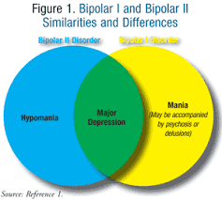
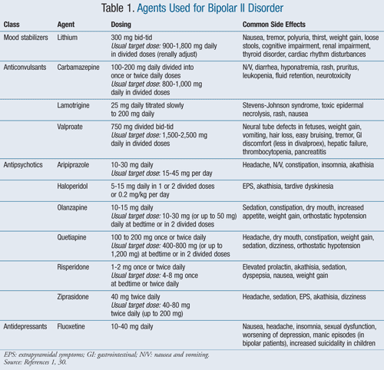
Bipolar II Disorder in Adults
Taylor Godfrey Nursing Student
Methodist University
March 2015
Abstract
Bipolar disorder is alterations in mood, with periods of mania, hypomania, psychosis, and depression. Bipolar II disorder is characterized by one or more episodes of major depression with at least one hypomanic episode. The risk for suicide increases greatly with these patients.
Treatment and Management
Patients who have acute manic episodes should be assessed for their risk of suicide, aggressiveness, and potential for violence to others. The patient needs to discontinue antidepressants, nicotine, and alcohol immediately.
Pharmacologic Therapy
Lithium is the drug used to treat mania and for the treatment and prophylaxis of bipolar disorder. Lithium is mainly for manic episodes. The most common side effects include nausea, tremor, polyuria and thirst, weight gain, loose stools, cognitive impairment, nephropathy, hypothyroidism and goiter.
Anticonvulsants can also be used because they decrease brain excitation, enhance inhibition by blocking low-voltage sodium-gated channels, lower glutamate and other excitatory amino acids, and potentiate the levels of GABA. Anticonvulsants used include valproate or divalproex, lamotrigine, and carbamazepine.
Antipsychotics some antipsychotics have demonstrated efficacy in patients with mania however they are rarely used for Bipolar II unless combined with other medications.
Antidepressants are not very effective at treating Bipolar II. A study shows that using fluoxetine with Lithium helps with relapse prevention of the lithium.
Evaluation and Assessment
Diagnosing Bipolar II disorder is complicated because many other mood disorders have manic episodes. A thorough assessment focusing on the endocrine and neurologic systems. Also, laboratory testing (including thyroid testing, CBC, blood chemistries, and urine toxicology testing), should be conducted to rule out other etiologies of mood disorders.
Pathophysiology
No gene has been identified to cause Bipolar II disorder; however recent studies are stating that it could be tryptophan hydroxylase 2 (TPH2) gene, which is an enzyme in the synthetic pathway for serotonin. Other studies suggest the CACNA1C gene, which codes for a subunit of calcium channels. The gene is involved in channel gating, supporting the use of lithium, which in turn results in the down-regulation of calcium channel subunits.
References
Soliman, M., Mahdavian, S., Honeywell, M., & Welch, T. (2011, November 26). Bipolar II Disorder in Adults: A Review of Management Options. Retrieved March 2, 2015, from http://www.uspharmacist.com/content/t/mental_health/c/31084

